Slide 1

Queses:
  Array and list representation,
  Operations (traversal, insertion and deletion)
Priority queues and Deques:
  Array and List representations

Slide 2
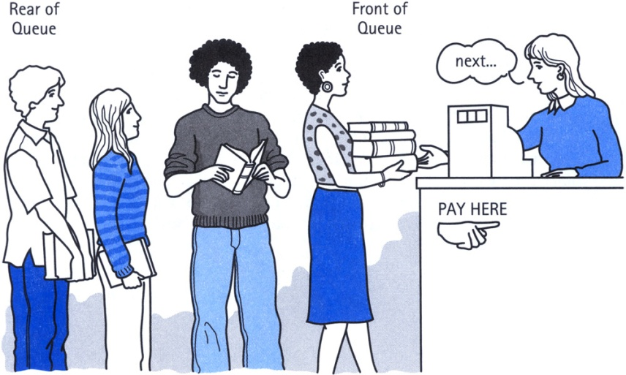
Definition of Queue
A Queue is an ordered collection of items from which items may be deleted at one end (called the front of the queue) and into which items may be inserted at the other end (the rear of the queue).
The first element inserted into the queue is the first element to be removed. For this reason a queue is sometimes called a FIFO (first-in first-out) list as opposed to the stack, which is a LIFO (last-in first-out).

Slide 3
Queue
items[MAXQUEUE-1]
. | .
. | .
. | .
items[2] | C
items[1] | B
items[0] | A
Rear=2
Front=0

Slide 4
Insert an item A
A new item (A) is inserted at the Rear of the queue
items[MAXQUEUE-1]
. | .
. | .
items[3]
items[2]
items[1]
items[0] | A | Front=0, Rear=0

Slide 5
Insert an item B
A new item (B) is inserted at the Rear of the queue
items[MAXQUEUE-1]
. | .
. | .
items[3]
items[2]
items[1] | B | Rear=1
items[0] | A | Front=0

Slide 6
Insert an item C
A new item (C) is inserted at the Rear of the queue
items[MAXQUEUE-1]
. | .
. | .
items[3]
items[2] | C | Rear=2
items[1] | B
items[0] | A | Front=0

Slide 7
Insert an item D
A new item (D) is inserted at the Rear of the queue
items[MAXQUEUE-1]
. | .
. | .
items[3] | D | Rear=3
items[2] | C
items[1] | B
items[0] | A | Front=0

Slide 8
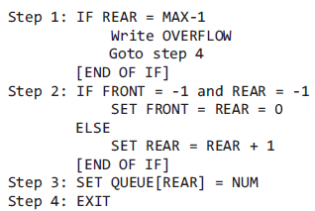
Insert Operation(Array)

Slide 9
Circular Queue Insertion using Array
1.F=1 and R=N or if F=R+1 then Write: OverFlow and return
2.If F=NULL then set F=1and R=1
Elseif R=N then set R=1
Else Set R=R+1
3.Set Q[R]=ITEM
4.Return

Slide 10
Delete A
An item (A) is deleted from the Front of the queue
items[MAXQUEUE-1]
. | .
. | .
items[3] | D | Rear=3
items[2] | C
items[1] | B | Front=1
items[0] | A

Slide 11

Delete B
An item (B) is deleted from the Front of the queue.
items[MAXQUEUE-1]
. | .
. | .
items[3] | D | Rear=3
items[2] | C | Front=2
items[1] | B
items[0] | A

Slide 12
Delete C
An item (C) is deleted from the Front of the queue
items[MAXQUEUE-1]
. | .
. | .
items[3] | D | Front=Rear=3
items[2] | C
items[1] | B
items[0] | A

Slide 13
Delete D
An item (A) is deleted from the Front of the queue.
items[MAXQUEUE-1]
. | .
items[3] | D | Front=Rear=-1
items[2] | C
items[1] | B
items[0] | A

Slide 14
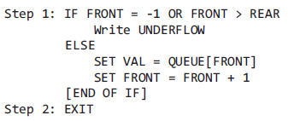
Delete Operation(Array)

Slide 15
Circular Queue Deletion using Array
1.F=NULL then Write: UnderFlow and return
2. Set ITEM=Q[F]
3. If F=R then set F=NULL and R=NULL
Elseif F=N then set F=1
Else Set F=F+1
4.Return

Slide 16
Insertion in Queue using LL
If AVAIL=NULL then Write OVERFLOW and Exit
Set NEW=AVAIL & AVAIL=LINK[AVAIL]
Set INFO[NEW]=ITEM & LINK[NEW] =NULL
If (FRONT=NULL then FRONT=REAR=NEW
Else Set LINK[REAR]=NEW & REAR=NEW
4.Return

Slide 17
Deletion in Queue using LL
If FRONT=NULL then Write UNDERFLOW and Exit
Set TEMP=FRONT
ITEM=INFO[FRONT]
FRONT=LINK[TEMP]
LINK[TEMP]=AVAIL & AVAIL=TEMP
EXIT

Slide 18
Priority Queue
More specialized data structure.
Similar to Queue, having front and rear.
Items are removed from the front.
Items are ordered by key value so that the item with the lowest key (or highest) is always at the front.
Items are inserted in proper position to maintain the order.

Slide 19
Deques
It is a double-ended queue.
Items can be inserted and deleted from either ends.
More versatile data structure than stack or queue.
E.g. policy-based application (e.g. low priority go to the end, high go to the front)
Two variations: Input restricted(allow insertion at only one end but allow deletions at both ends) and output restricted(restricted(allow deletion at only one end but allow insertions at both ends)

Slide 20
Thank You

